Slide 1

Predicting Movie Box Office Success with Data Science
Turning Creativity into Predictability
Notes:
Hello guys my ML project Idea is to (read Slide )

Slide 2


Introduction
What is the Film Industry Challenge?
Box office success is unpredictable.
Many factors: budget, cast, director, marketing, audience reception.
Even big-budget films sometimes fail; small movies sometimes win.
Why is Prediction Important?
Helps studios, investors, and streaming platforms make better decisions.
Reduces financial risk.
The Big Question:
"Can we predict a movie’s success before it hits theaters?"
Notes:
Can we predict a movie’s box office success before it even hits theaters?
In the movie industry, success is famously unpredictable. Big budgets, famous actors, huge directors — sometimes even those don’t guarantee a hit. At the same time, small movies with almost no budget sometimes surprise everyone and become blockbusters.
So why does this matter? Because being able to predict a movie’s success could save studios millions of dollars. It could help streaming platforms decide what to buy. It could help theaters plan what to show and when. In short — prediction could change the business of entertainment.
Today, I'll walk you through how we approached this problem using data science — in a way that even non-technical audiences can understand.

Slide 3
Goals of the Research
Our Mission:
Predict a movie’s box office revenue before release.
Research Goals:
Find key factors that influence revenue.
Build models that predict success based on early information.
Who Benefits?
Studios & producers: Better budget planning.
Marketers: Smarter promotional strategies.
Streaming platforms: Smarter acquisitions.
Theaters: Better scheduling decisions.
Notes:
🎯 Goals of the Research (~2–3 minutes)
The goal of our project was simple but ambitious:
👉 Predict a movie’s box office revenue before it releases, based only on information available early — like its genre, budget, cast, and release date.
We wanted to answer:
What factors really drive movie success?
Can we build models that predict box office performance early enough to make a difference?
Who benefits?
Studios: for better budget planning.
Marketers: for smarter promotional strategies.
Streaming platforms: for better content acquisitions.
Theaters: for more profitable scheduling.
If we could find patterns early, every major player in the entertainment ecosystem could make more informed, smarter decisions.

Slide 4
Data Sources and Preparation
Where Our Data Came From:
TMDb API (The Movie Database)
Popular Movies
Top-Rated Movies
Genre, Language, Budget, Revenue details.
Data Cleaning Steps:
Filled missing values.
Mapped numeric codes to human-readable genres.
Created new useful features like release season, franchise status, etc.
Before vs After Cleaning:
Raw data: messy, missing info.
Clean data: consistent, enriched, ready for modeling.
Notes:
We started with raw data from a popular open-source platform — the TMDb API (The Movie Database).
It included information like:
Movie budgets and revenues
Genre and language
Popularity metrics
Cast and directors
At first, the data was messy. There were missing values, codes instead of readable names, and lots of extra noise.
After cleaning:
Missing information was filled.
Genres and languages were mapped into readable forms.
New features were created, like "Release Season" and "Franchise Status" — which turned out to be very useful for prediction.
This gave us a much richer, cleaner dataset to work with.

Slide 5
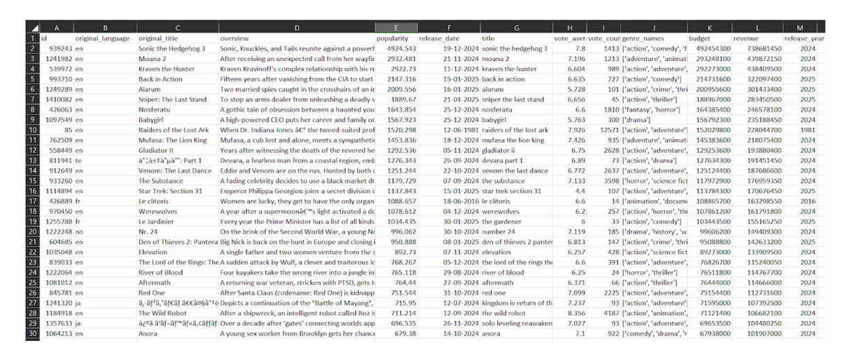
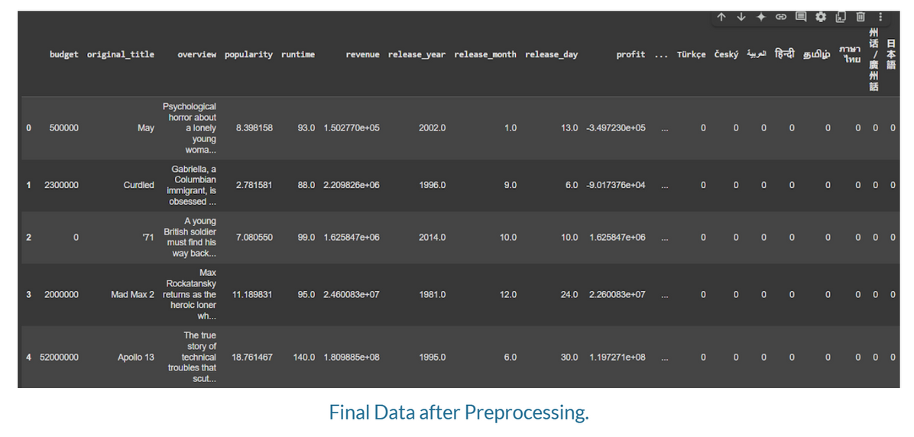
Raw Data

Slide 6
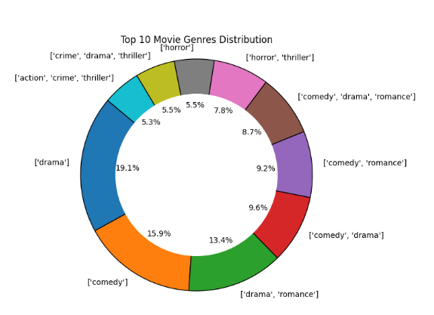
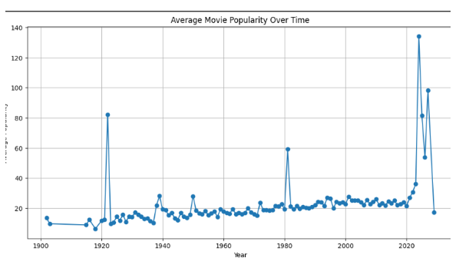
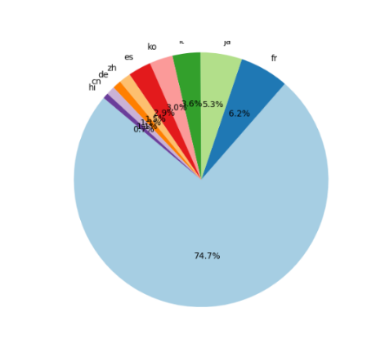
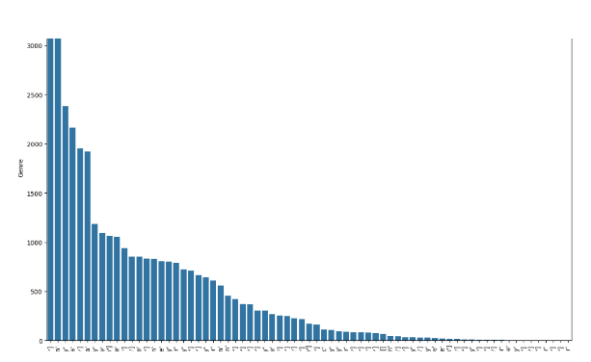
Interesting Findings
Visual Data Insights
Popularity Trends: Movie buzz is growing — thanks to streaming and social media.
Top Genres: Action, Thriller, and Adventure movies dominate.
Top Earning Movies: Franchises and Superhero movies earn the most.
Language Trends: English movies lead globally; non-English growing via Netflix etc.
Notes:
🔥 Most Interesting Findings (~5–8 minutes)
Now let’s talk about what we found — and which methods really mattered.
1. Visual Data Insights
Before modeling, we learned a few key things just by looking at the data:
Action, Adventure, and Thriller movies dominate.
Franchises and Superhero movies make the most money.
English-language films dominate globally, but non-English films are growing — thanks to platforms like Netflix.
Popularity trends are rising fast, fueled by streaming and social media.
These trends helped guide how we built our models.

Slide 7
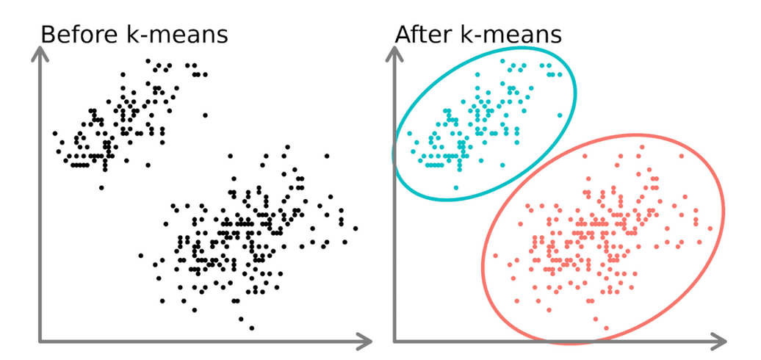
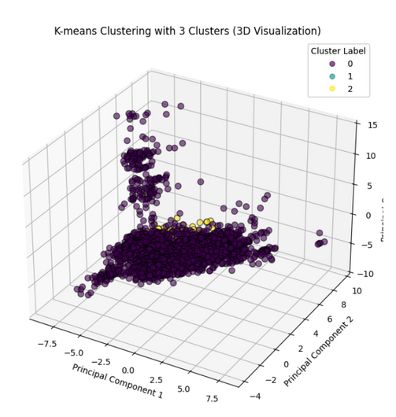
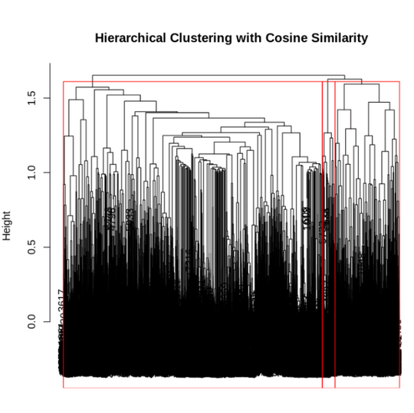
Modeling and Key Learnings
What We Tried:
Grouped movies using K-Means Clustering based on numerical features like budget, revenue, popularity, and profit.
Used PCA (Principal Component Analysis) to simplify the data while keeping most of its information.
Key Insight:
Identified 3 natural clusters in the data that reflect different types of movies (e.g., low-budget, mid-range, blockbuster).
The Silhouette method confirmed that 3 clusters gave the best separation.
Importance:
Useful for discovering hidden groupings in movies without needing labels.
Helps segment movies early in the analysis, and gives a foundation for targeted marketing or budgeting strategies.
Notes:
Now coming to modeling methods
K-Means Clustering
What it is: A model that groups similar movies together — without knowing anything beforehand.
How it works: It looks at things like budget, revenue, and popularity, and automatically sorts movies into "natural" clusters based on how close they are in the data.
We grouped movies into clusters — without labels — purely based on their features like budget, revenue, and popularity.
We found three natural movie groups:
Low-budget, independent films
Mid-range performers
Blockbusters
This clustering helps segment movies early, even without knowing their box office outcome yet.

Slide 8
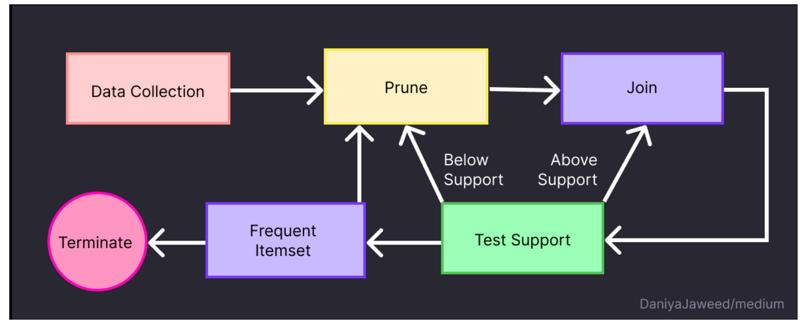
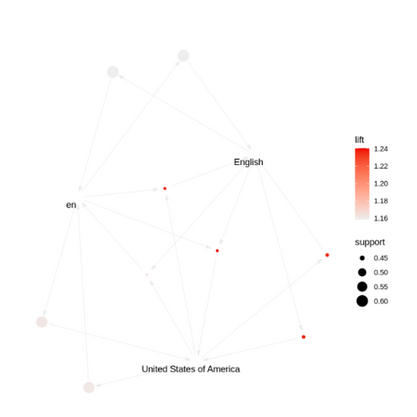
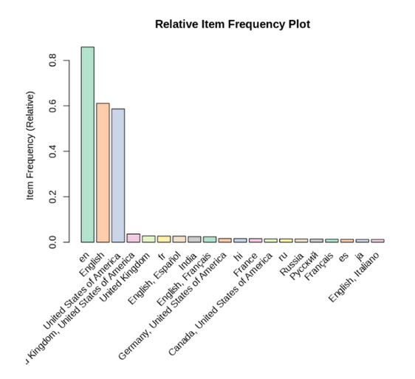
ARM
What We Tried:
Analyzed patterns like country-language links.
Key Insight:
Found strong US-English association.
Importance:
Early trends in language and location can hint at movie success.
Notes:
Association Rule Mining (ARM)
What it is: A method to find relationships between things that often happen together.
How it works: If a movie is in English and produced in the USA, there’s a high chance it follows other similar patterns. We find "if this, then that" rules from the data.
We explored relationships like language and country.
One interesting pattern:
US-produced movies in English dominate massively — no surprise.
But smaller countries/languages showed patterns too, helping identify growing markets.

Slide 9
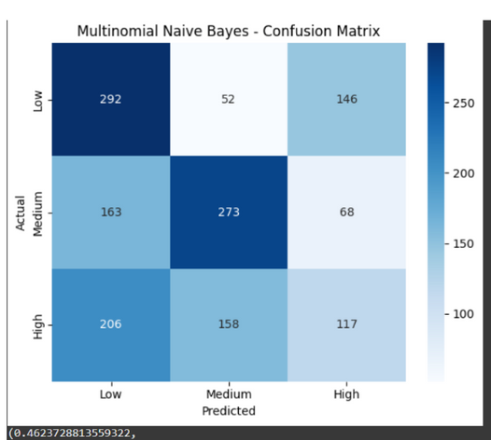
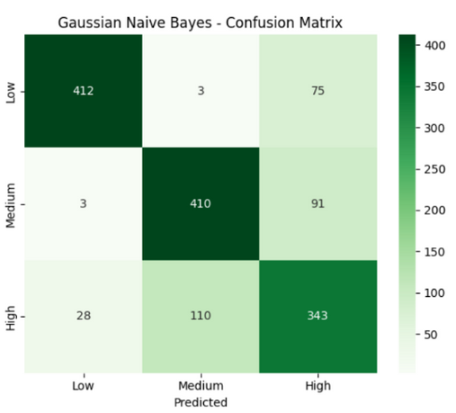
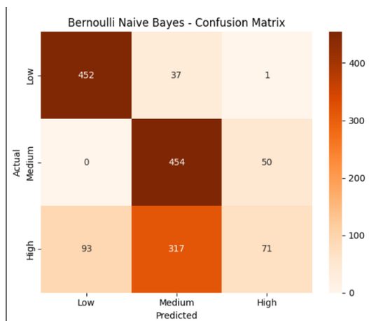
Naive Bayes
What We Tried:
Built simple probability models to predict movie categories.
Key Insight:
Worked okay (GaussianNB ~79% accuracy).
But not the best fit for movie financial data.
IImportance:
Quick models, but struggles with complex patterns.
Notes:
Naive Bayes
What it is: A simple model that predicts outcomes based on basic probabilities.
How it works: It assumes all features work independently and makes a prediction based on which outcome is most likely. Like guessing weather only based on humidity.
We tested simple probability-based models.
While fast, Naive Bayes struggled with complex financial relationships. It achieved about 79% accuracy — good, but not strong enough for serious financial predictions.

Slide 10
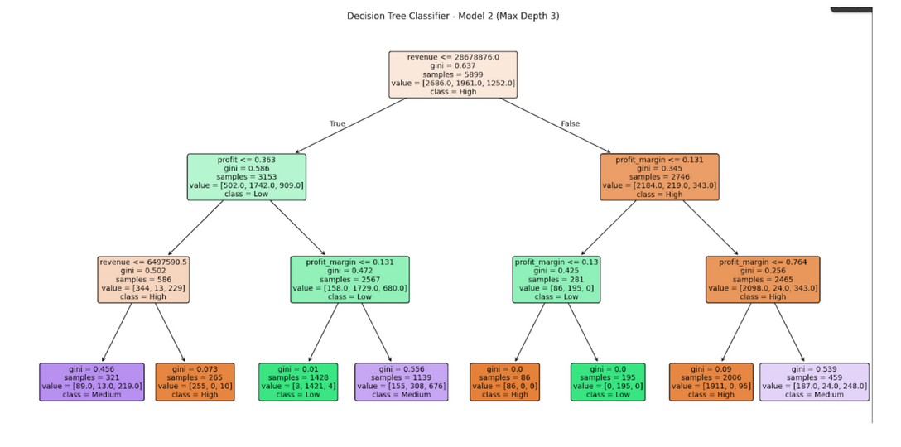
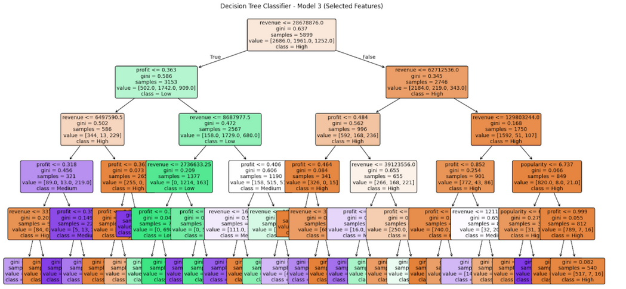
Decision Trees
What We Tried:
Created rule-based trees to classify movie success.
Key Insight:
Easy to understand how decisions are made.
Prone to overfitting without careful control.
Importance:
Great for explaining "why" a movie might succeed or fail.
Notes:
Decision Trees
What it is: A series of decisions arranged like a flowchart — like a game of 20 Questions.
How it works: The model asks yes/no questions — "Is the budget high? Is it an action movie?" — and leads down a path to a final prediction.
We built rule-based trees to classify movie success.
They were very easy to explain ("If a movie has a high budget and a summer release, it’s likely a hit.") But without careful tuning, they tended to overfit — memorizing training data instead of generalizing.
Still, great for visual explanation.

Slide 11
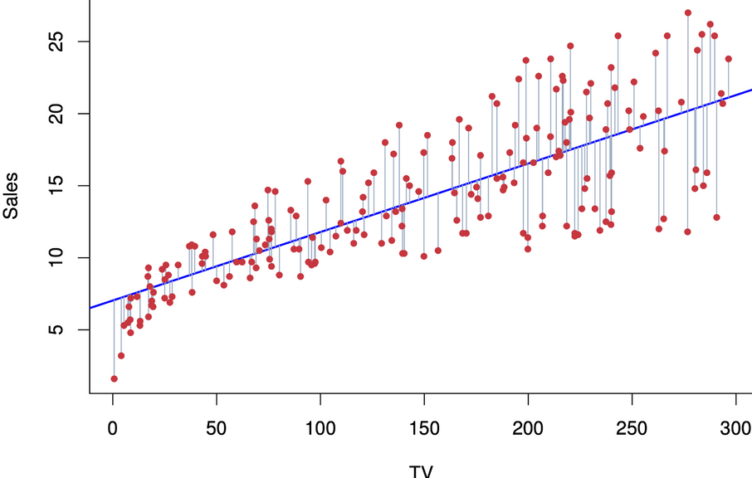
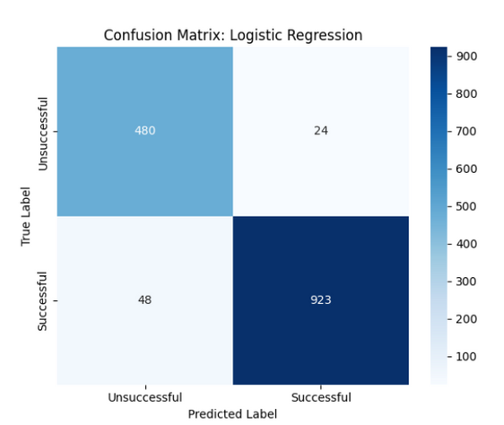
Logistic Regression
What We Tried:
Modeled movie success vs failure using statistical relationships.
Key Insight:
Strong accuracy (~95%).
Very simple and effective model.
Importance:
A very good first prediction tool, great for fast decision-making.
Notes:
Logistic Regression
What it is: A method that predicts chances of success or failure.
How it works: It draws a boundary line based on the data — one side of the line is a successful movie, the other side is not.
Logistic Regression performed very strongly.
About 95% accuracy.
Fast, simple, and great at drawing clean decision boundaries.
Worked very well for predicting movie success vs failure.
It became one of our most reliable early models.

Slide 12
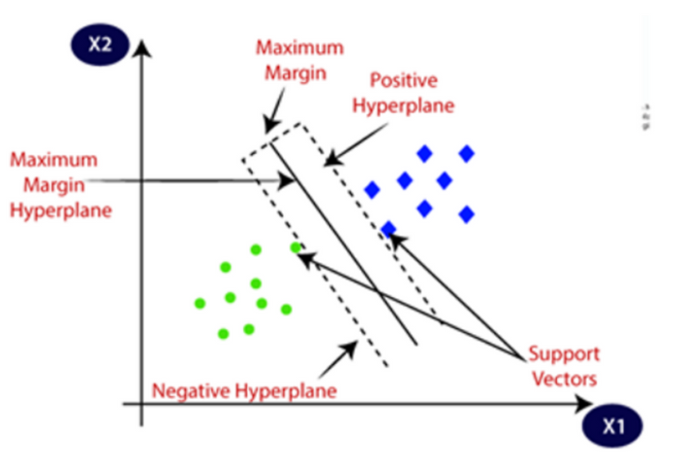
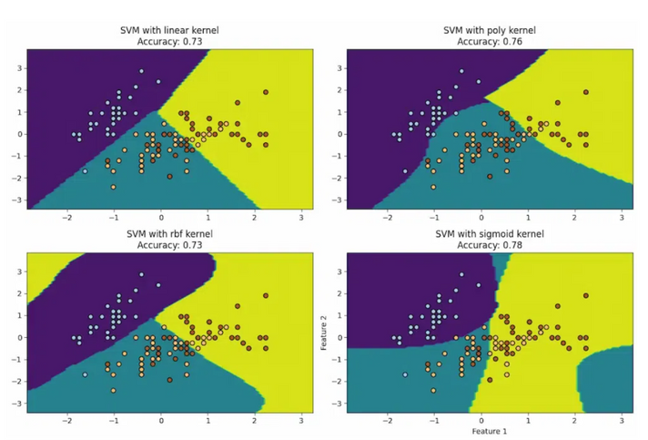
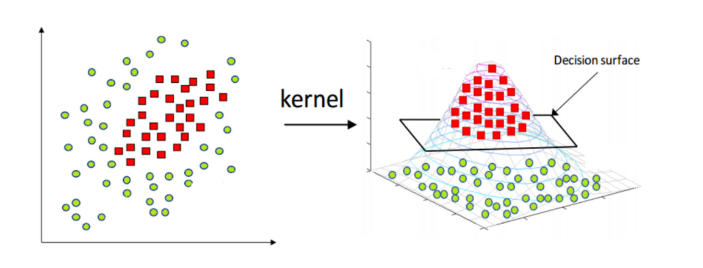
Support Vector Machines (SVM)
What We Tried:
Separated movie types using mathematical hyperplanes.
Key Insight:
Linear SVM ~98% accuracy!
Created very clean separation between movie categories.
Importance:
Best at drawing strong boundaries for success prediction.
Notes:
Support Vector Machines (SVM)
What it is: A model that tries to separate different groups of movies with the widest possible gap.
How it works: It finds the best dividing line (or surface) between categories so that the groups are as far apart as possible.
SVM models created very sharp separations between movie categories.
Linear SVM reached about 98% accuracy.
It was one of our most accurate methods — drawing very clean boundaries between blockbuster movies and the rest.

Slide 13

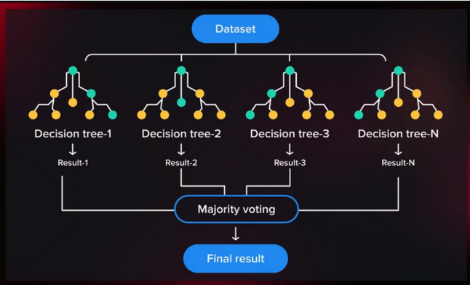
Ensemble Models (Random Forest, XGBoost, AdaBoost)
What We Tried:
Combined multiple models to get stronger predictions.
Key Insight:
XGBoost achieved 99% accuracy!
Very reliable and stable model for predicting movie revenue.
Importance:
Best performance overall — powerful model for studios and investors.
Notes:
Ensemble Models (Random Forest, XGBoost, AdaBoost)
What it is: Teamwork between lots of small models to make a much better prediction.
How it works: Instead of relying on one decision tree, we build hundreds (Random Forest), or carefully fix mistakes step-by-step (XGBoost and AdaBoost). Then we combine their answers to get a stronger, more accurate result.
8. Ensemble Models (Random Forest, XGBoost, AdaBoost)
Finally, we combined multiple models together — an approach called Ensemble Learning.
The results were fantastic:
Random Forest: Very high accuracy. With 95%
AdaBoost: Strong, but a little sensitive to noise. With accuracy of 93%
XGBoost: 99% accuracy — the best model overall.
If a studio or streaming platform wants the most accurate prediction possible, XGBoost would be the ideal choice.

Slide 14
Conclusion
Success is Multidimensional:
Budget matters — but story, genre, timing, and audience buzz matter too.
Bigger Isn’t Always Better:
High budget ≠ guaranteed hit. Smart storytelling + right release time is key.
Predicting Early Helps Everyone:
Studios and streaming companies can plan better.
Investors can reduce risk.
Marketers can focus campaigns where it matters.
Future Potential:
Real-time sentiment analysis (Twitter, trailers).
Smarter marketing based on early buzz.
Dynamic adjustment of strategies as data comes in.
Notes:
📢 Non-Technical Conclusions (~5 minutes)
So — what does all this mean without the technical jargon?
1. Success is Multidimensional. It’s not just budget. Success comes from smart storytelling, good timing, genre appeal, and audience buzz.
2. Bigger Isn’t Always Better. Having a huge budget does not guarantee a hit. Some modest-budget movies performed far better than expensive ones.
3. Early Prediction is Powerful. If you can predict success early:
Studios can allocate budgets better.
Marketers can focus their promotions smarter.
Streaming services can pick winners before competitors.
Investors can lower their financial risks.
4. Future Potential is Exciting. Imagine combining this model with real-time data: Twitter buzz, YouTube trailer views, early critic scores.
The system could dynamically adjust predictions — almost like having a financial advisor for movies.
Final Thought:
Movies will always be an art form. But with the right data — we can make smarter art.
Thank you!

Slide 15
Thank You
“Movies are art — but with the right data, we can make smarter art.”

